Slide 1
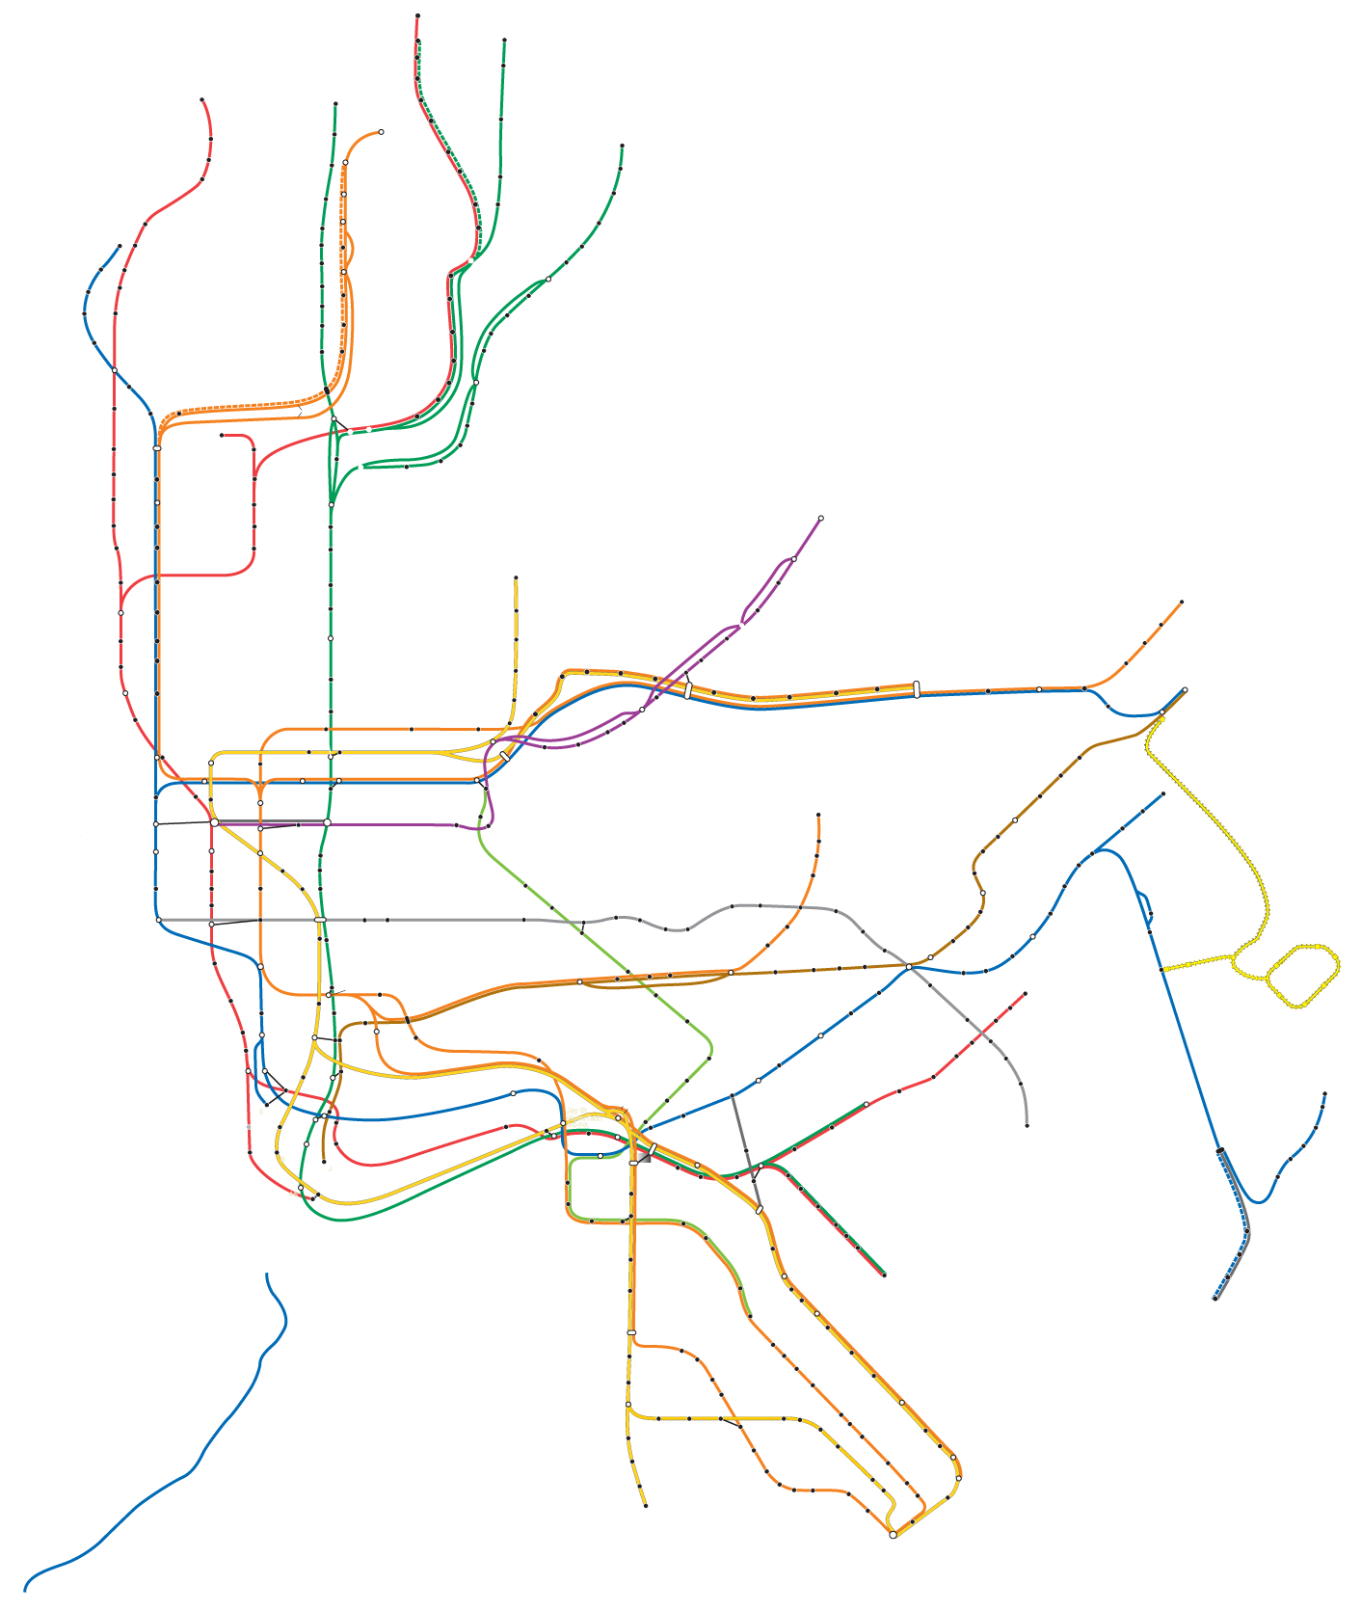
Women Tech
Women
Yes
Gala Outreach
Recommendation
Maya Midzik, Vicky Szuflita, Peter Min
4/13/2018
Notes:
VICKY

Slide 2
Our Goal
Ensure a successful WTWY gala.
The success of the gala will be determined by the number of attendees, and fundraising total.
Notes:
VICKY

Slide 3
Our Challenge
With so many stations, and limited resources,
how to do we deploy teams in an intelligent way,
to reach our goals?
Notes:
VICKY

Slide 4



Our Strategy
To achieve our fundraising goals we must reach...
Our target:
Those with a high income.
Those with an interest in tech.
To achieve our attendance goals we must reach them at...
The Best Time of Day:
When the highest density of our target will be entering and exiting those stations.
Notes:
VICKY

Slide 5





OUR 1st TARGET:
HIGH INCOME
RESIDENTIAL
STATIONS
THE BEST TIME OF DAY
AM
ENTER
Traffic
Time of Day
ENTRIES
PM
EXIT
EXITS
Notes:
Maya
The trend of our target demographic, for entries and exits.
AM (6am - 12pm)
PM (4pm - 12am)
G

Slide 6
Our Methods
High Entry
(Going to work)
Turnstile Data
(MTA) - March 2018
(weekdays)
High Traffic
& Income Stations
AM
Aggregate
Station Zip Code
(Google Geolocation API)
PM
Income Data
(ACS Census)
High Exit
(Coming home)

Slide 7
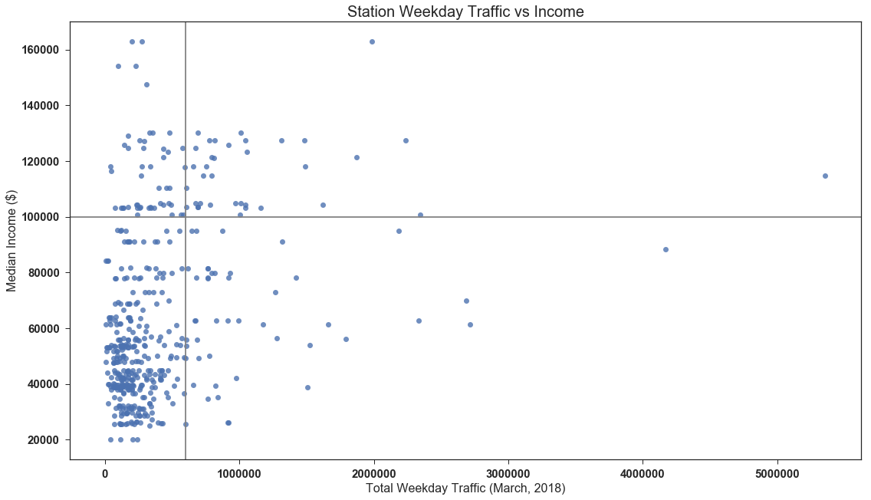
TOOLS:
Google Geocode API
DATA SOURCES:
MTA Turnstile usage data : March 2018
ACS zip code to income data
Notes:
To ensure we include potential high income donors, we set the minimum threshold for income at $100,000
Setting the total traffic in the month of march at 600,000, we were able to narrow down our list to 36 potential stations

Slide 8
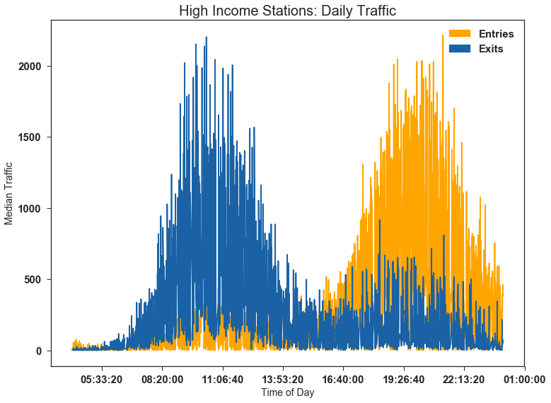
Notes:
Point at the map and what we’re looking for.

Slide 9
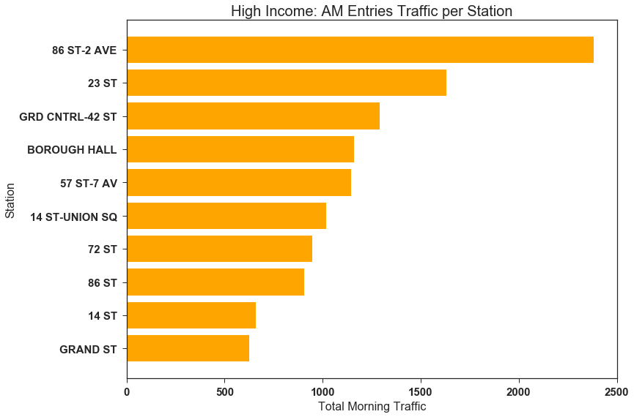
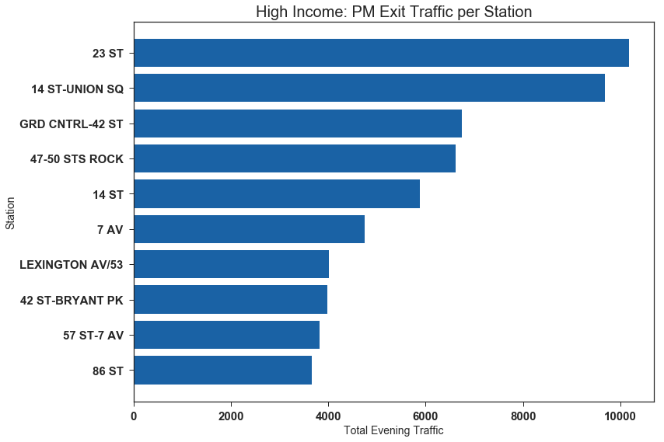
AM Entries
86th St/2nd Ave
23rd St/7th Ave
Borough Hall
57 St/7 Ave
PM Exits
23rd St/7th Ave
14th - Union Square
47-50 St Rock
14th St
Notes:
Peter
Skipped Grand Central because a lot of commuter lines go through grand central
May not be representative of the demographic we’re interested in

Slide 10

Our 2nd TARGET:
TECH HUB
STATIONS
THE BEST TIME OF DAY
AM
EXIT
PM
ENTER
ENTRIES
EXITS
Notes:
Maya

Slide 11
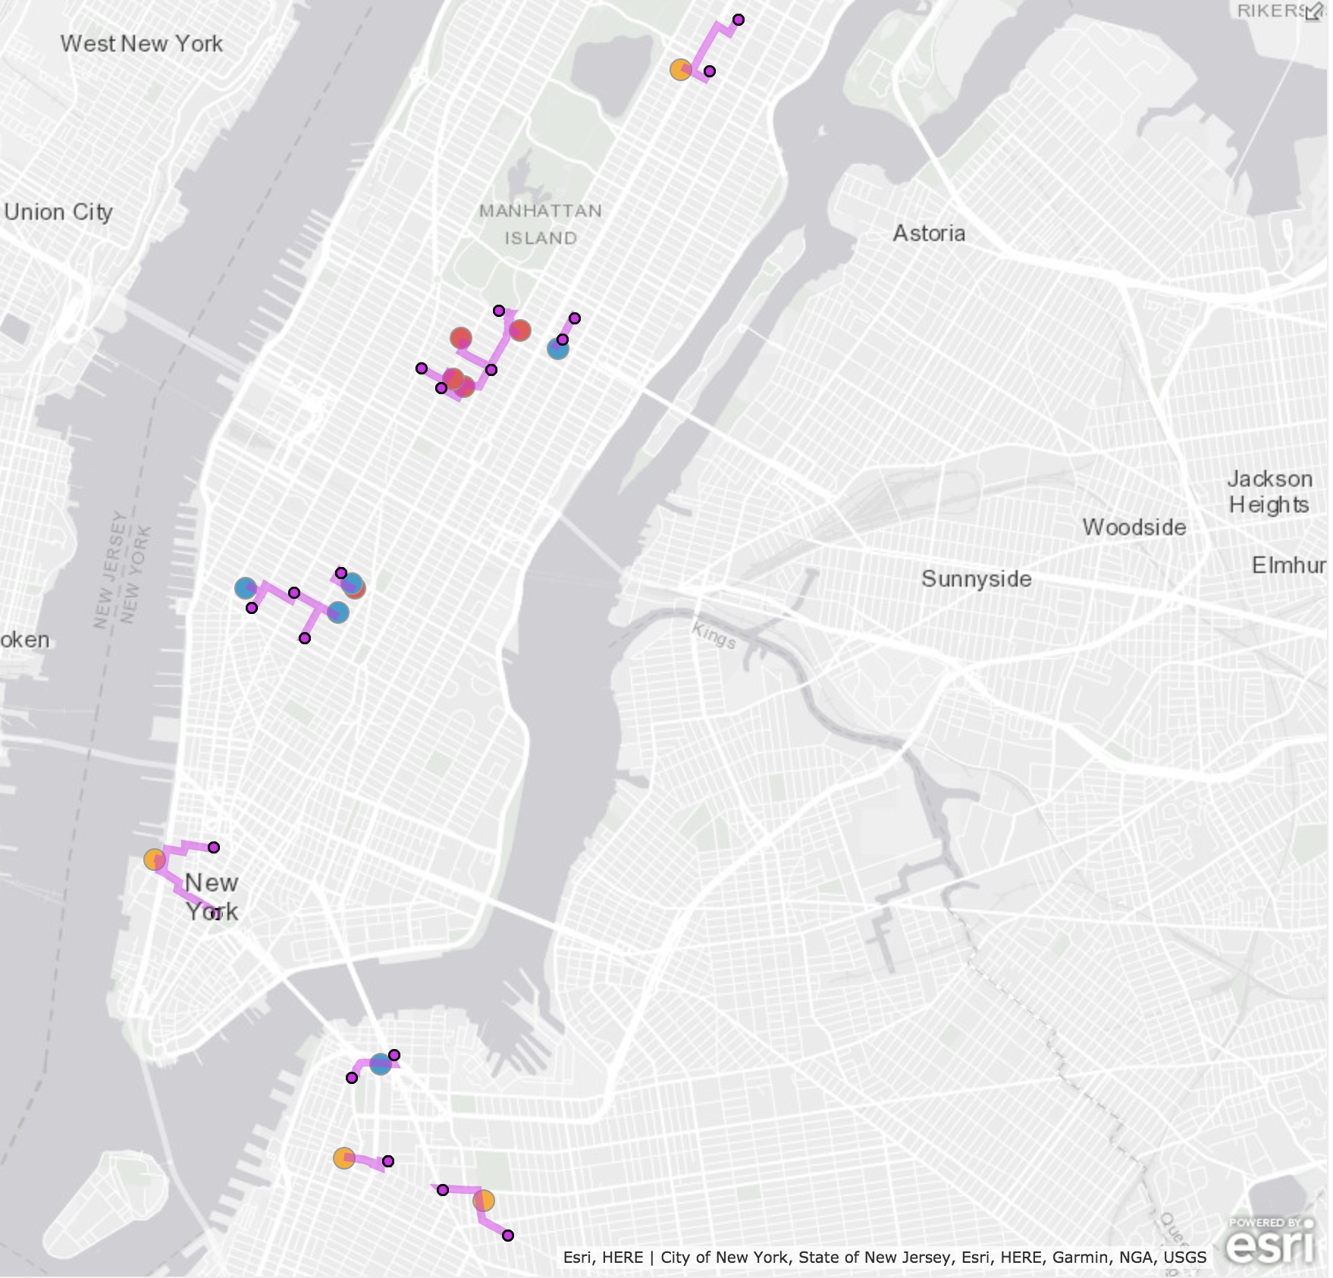














Girls Who Code
Major Donors, $250k+
Technical Companies
800+ employees
Technical High Schools
1,000+ students
Notes:
Maya

Slide 12
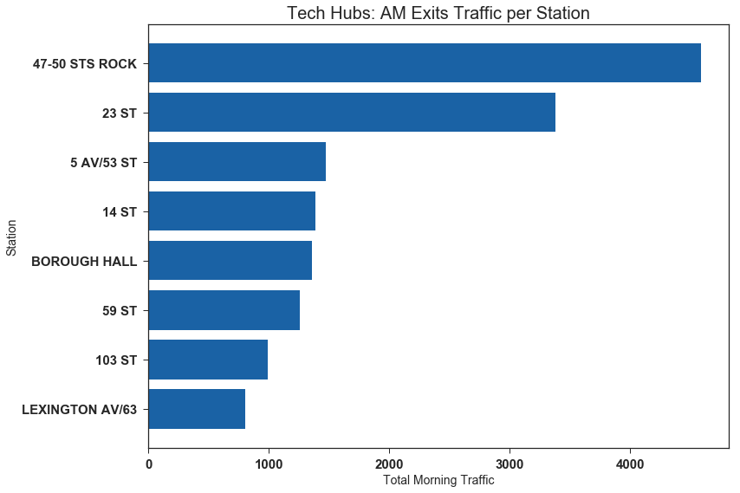
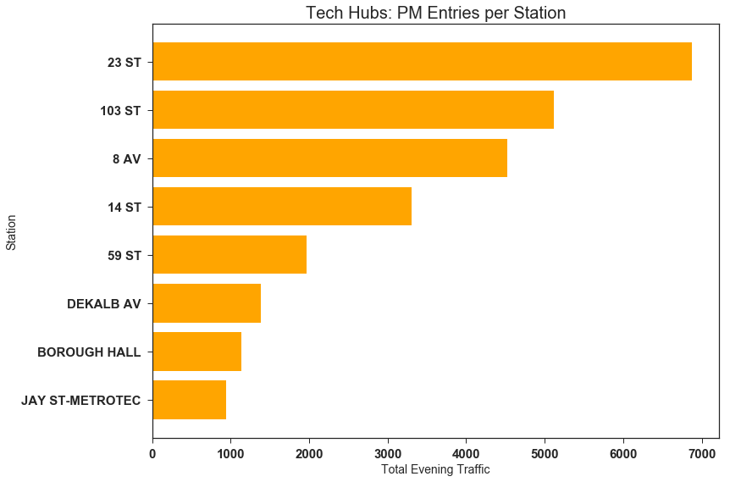
AM Exits
47th/50th Rock Center
23rd St/6th Ave
5th Ave/53th St
14th St/6th Ave
PM Entries
23rd St/6th Ave
103rd St
8th Ave
14th St/6th Ave
Notes:
Maya

Slide 13
Deploying Teams
AM
PM
High Income Stations
23rd St/7th Ave
Borough Hall
86th St/2nd Ave
57 St/7 Ave
High Income Stations
23rd St/7th Ave
14th/Union Square
14th St/6th Ave
47-50 Sts Rock
Stations Near Tech
23rd St/5th Ave
47th/50th Rock Center
5th Ave/53th St
14th St/6th Ave
Stations Near Tech
23rd St/5th Ave
103rd St
8th Ave
Notes:
Vicky
AM: 7am - 11am
PM: 4pm - 8pm

Slide 14
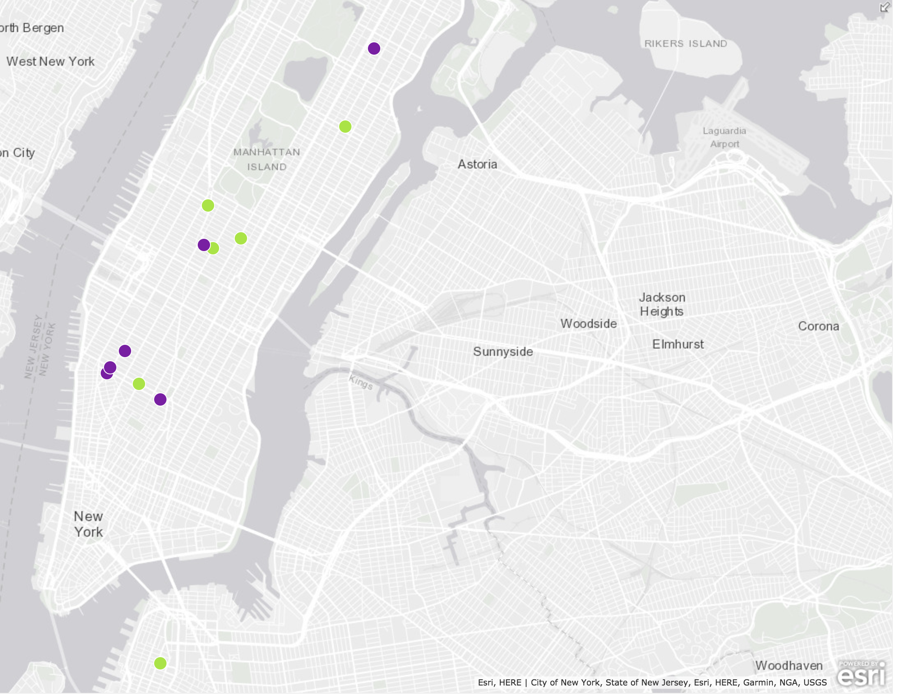
za
AM
PM
Notes:
Vicky

Slide 15
Future Work
Additional Data to Incorporate
Commuter % from census data
Gender data from census data
Weekend patterns
Longer time frame/seasonal trends
Run A/B tests to test signature conversions
Create interactive map for stations with a metric to help teams navigate traffic matters

Slide 16
Thank You!

Slide 17
STATION | LINENAME | Median Income
GRD CNTRL-42 ST | 4567S | $102,524.00
14 ST-UNION SQ | LNQR456W | $89,999.00
47-50 STS ROCK | BDFM | $113,846.00
PATH NEW WTC | 1 | $145,459.00
59 ST COLUMBUS | ABCD1 | $108,286.00
LEXINGTON AV/53 | EM6 | $93,107.00
86 ST | 456 | $105,456.00
42 ST-BRYANT PK | BDFM7 | $113,800.00
72 ST | 123 | $113,800.00
JAY ST-METROTEC | ACF | $92,175.00
BOWLING GREEN | 45 | $110,184.00
72 ST-2 AVE | Q | $113,800.00
5 AV/53 ST | EM | $93,107.00
BOROUGH HALL | 2345R | $92,175.00
23 ST | FM | $93,702.00
57 ST-7 AV | NQRW | $130,082.00
14 ST-UNION SQ | 456LNQRW | $89,999.00
23 ST | 6 | $93,702.00
77 ST | 6 | $112,268.00
49 ST | NQRW | $113,846.00
LEXINGTON AV/63 | F | $108,155.00
1 AV | L | $102,524.00
66 ST-LINCOLN | 1 | $108,286.00
51 ST | 6 | $93,107.00
68ST-HUNTER CO | 6 | $113,800.00
86 ST-2 AVE | Q | $105,456.00
GRAND ST | BD | $102,524.00
23 ST | NRW | $93,702.00
14 ST | ACEL | $92,359.00
14 ST | FLM123 | $92,359.00
7 AV | BDE | $130,082.00
23 ST | CE | $93,702.00
CORTLANDT ST | RNW | $111,220.00
86 ST | 1 | $105,456.00
8 AV | ACEL | $98,450.00
14 ST | 123FLM | $92,359.00

Slide 18
Notes:
Maya

Slide 19
Notes:
Peter

Slide 20
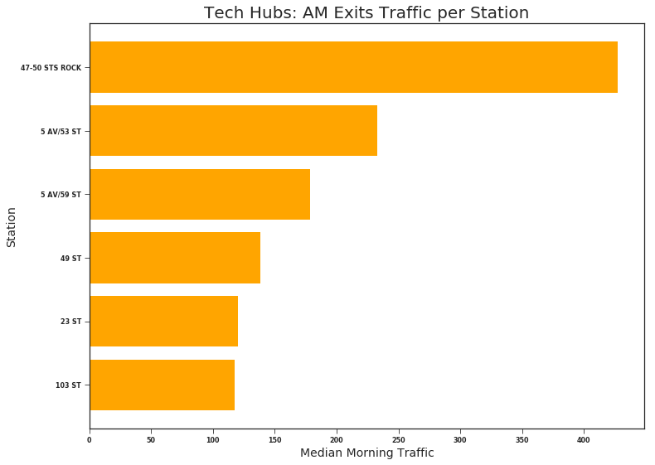
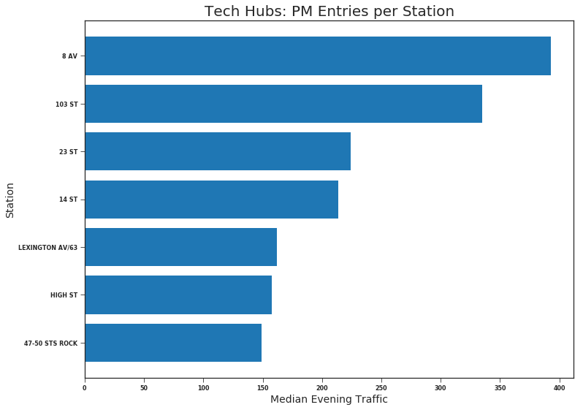
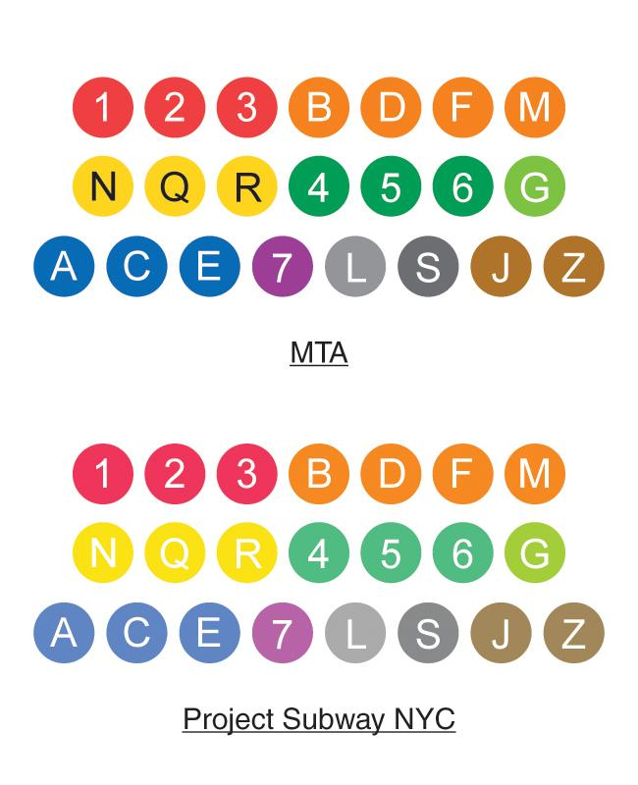
47th/50th Rock Center
5 AV/53 St
5th Ave/59th St
49th St
8th ave
103rd street
23rd street
14th street

Slide 21
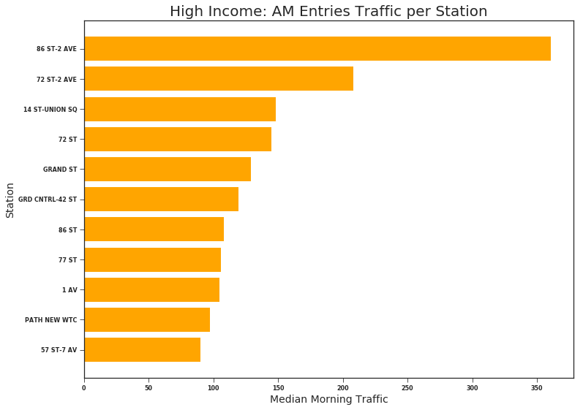
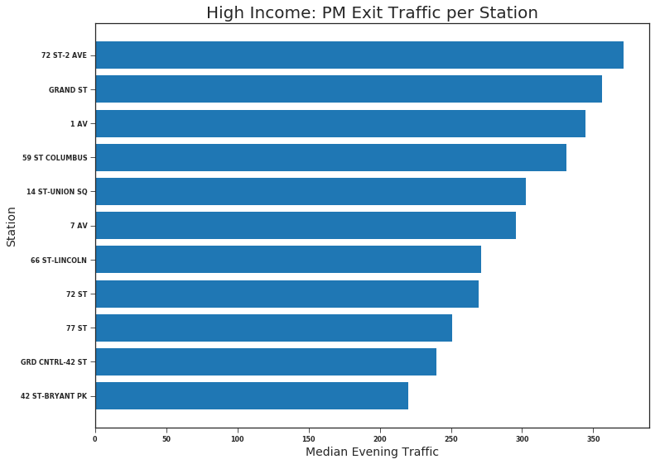

86th St/2nd Ave
72nd St/2nd Ave
14th St - Union Square
72nd Street/CPW
72nd St/2nd Ave
Grand Street
1st Ave
59th St Columbus

Slide 22
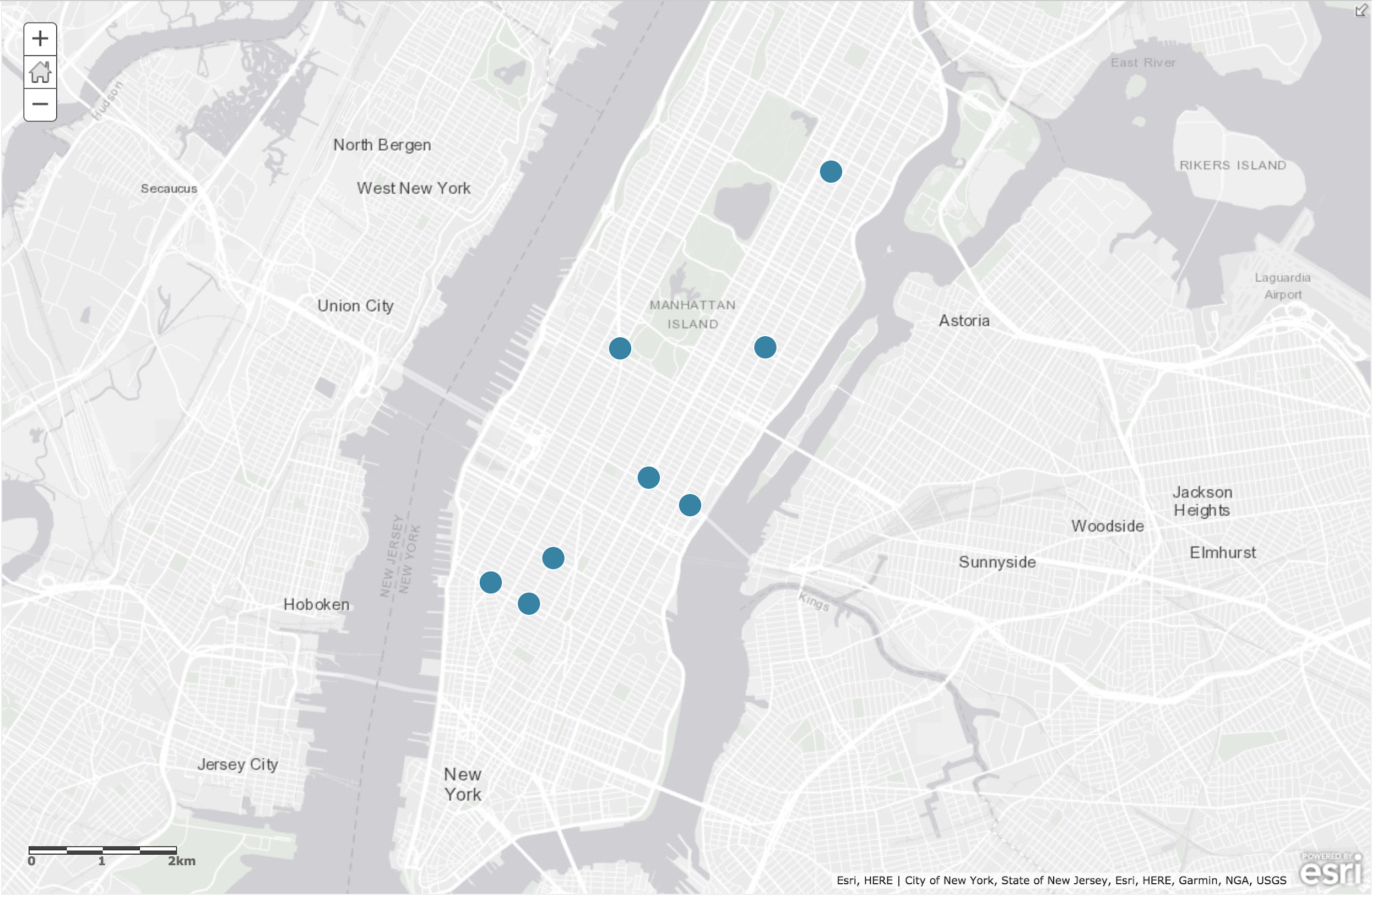
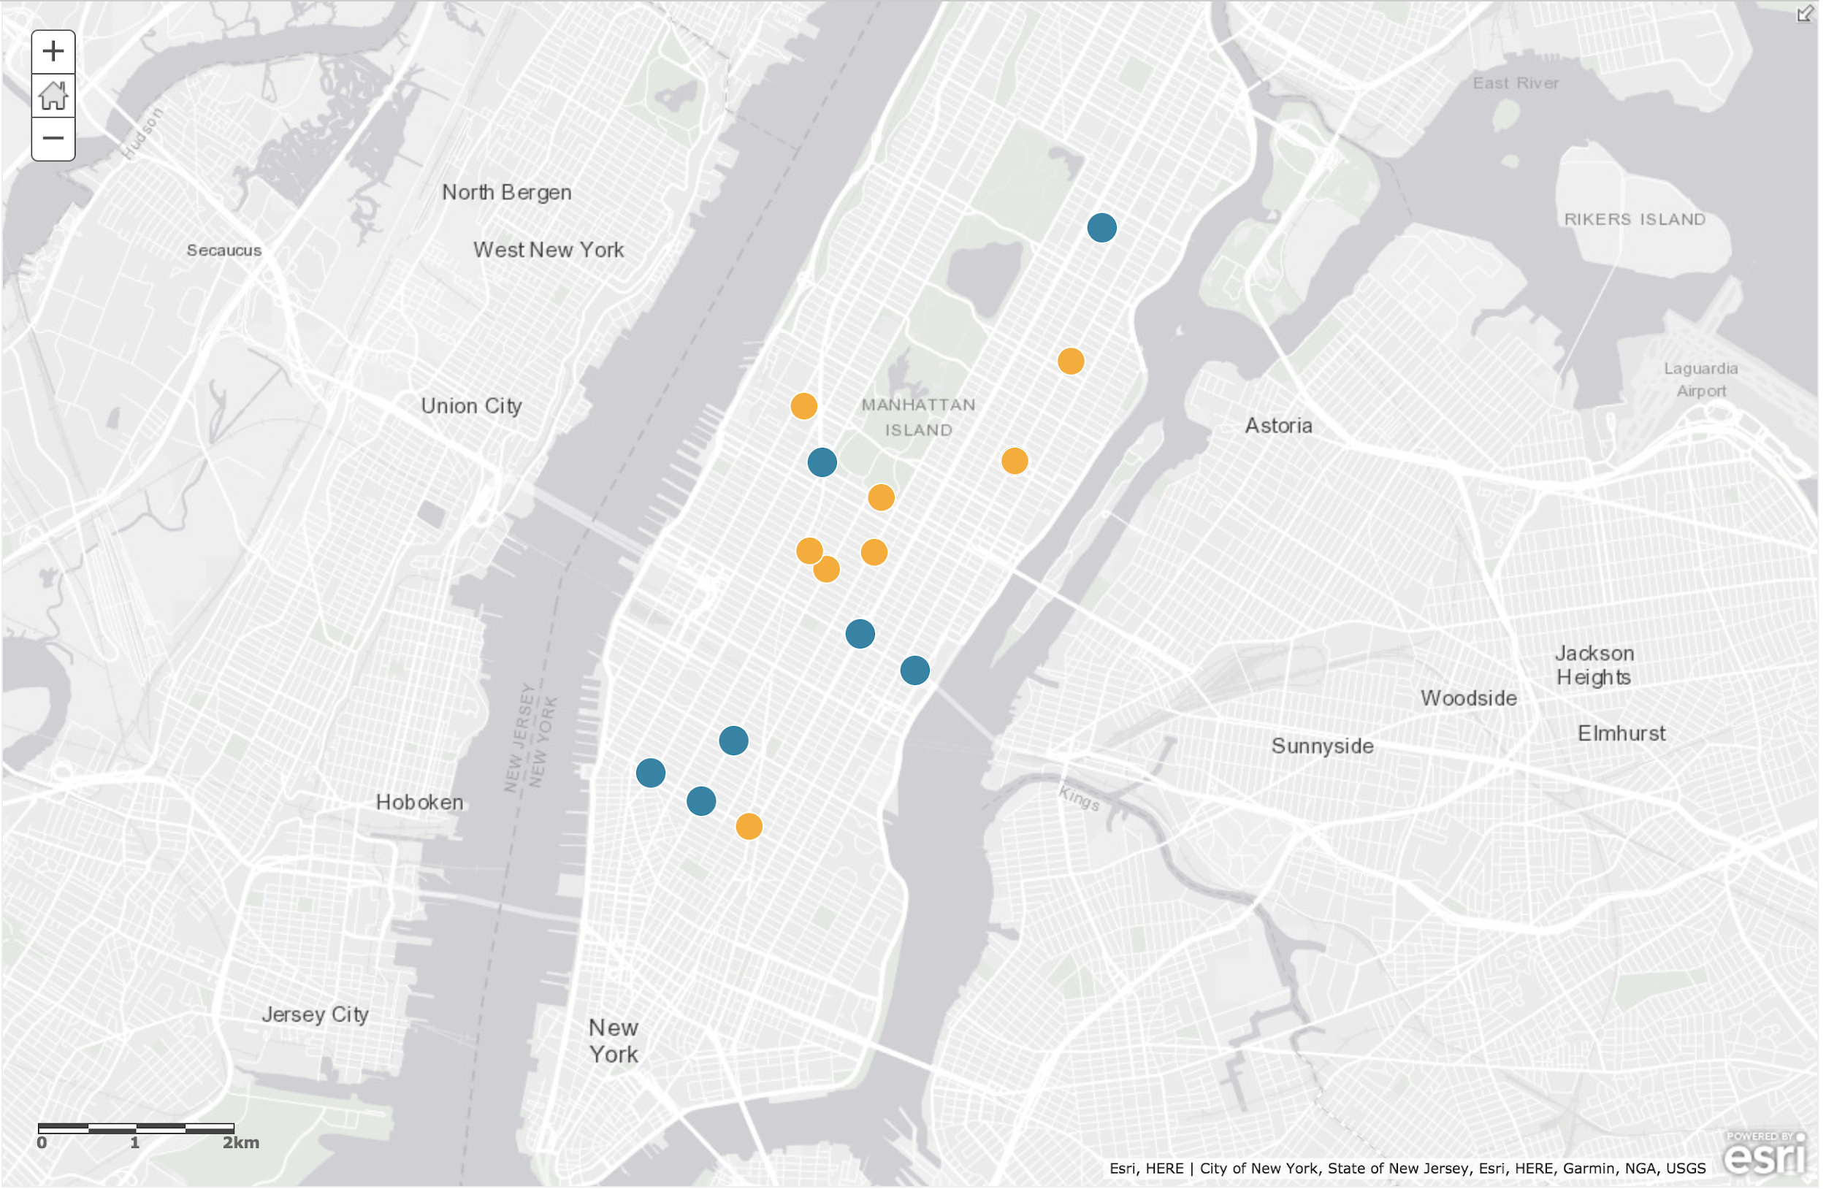
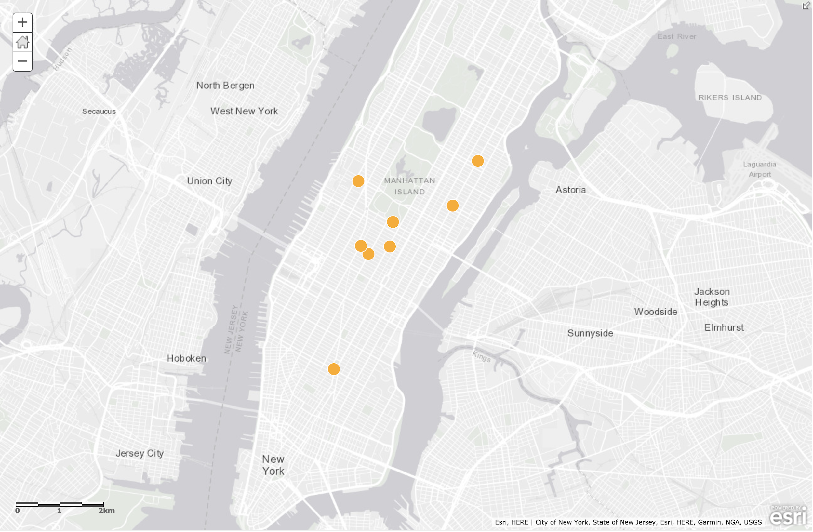
AM
PM

Slide 23
APPENDIX

Slide 24
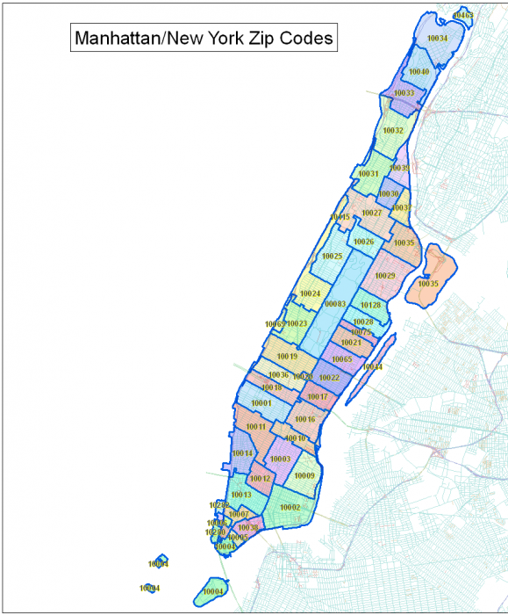
AM
PM
FPO
PLACEMENT MAP
List…
AM
PM

Slide 25
Our Strategy
To achieve our fundraising goals we must reach...
Those with a high income.
Those with an interest in tech.
To achieve our attendance goals we must reach them at...
When the highest density of our target will be entering and exiting those stations.
Our target
The
best time

Slide 26
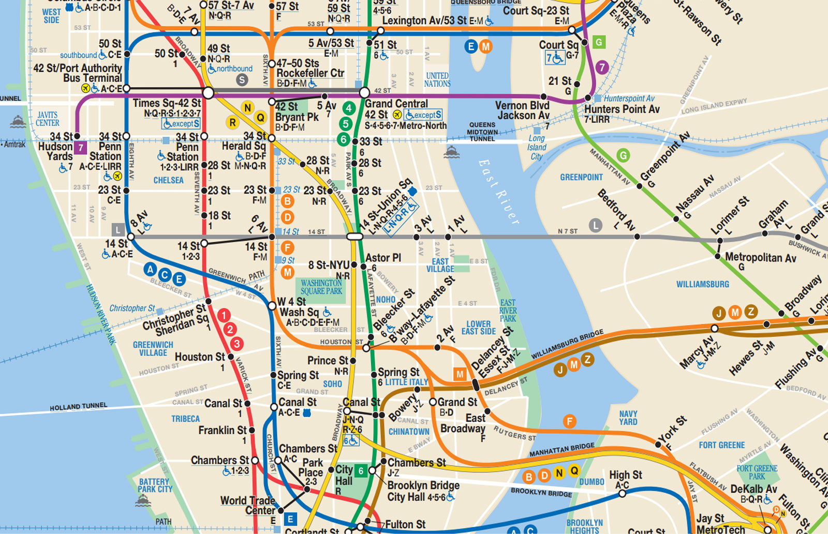
Notes:
App Nexus: 28 W 23rd St, TRAINS 23rd R/W, F
Accenture: 54th and 6th, TRAINS 57thst F, 7th ave BDE, Rock Center
AT&T: Rock Center
Deloitte: Rock Center
GM: 59th and Madison TRAINS, 59th, Lexington ave
Microsoft: 8th ave & 41st, TRAINS, Time Square
Packer, Collegiate, Lab, Brooklyn Tech, Stuy,

Slide 27
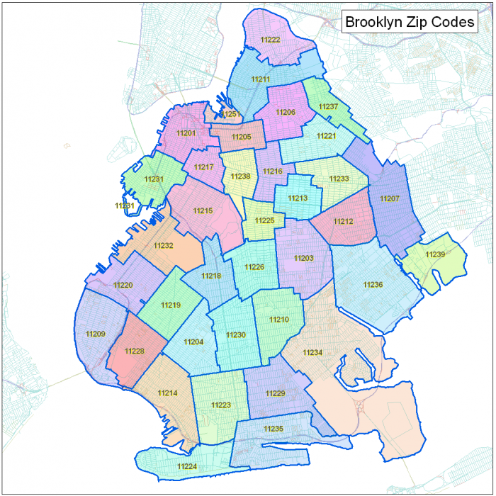
Notes:
11215 -Brooklyn, Park slope
11210-
10003-
10208
10282
10013
10007
10014
10011
10010
10003
10022
10017
10065
10021
10023
10069
10024
10028
10128

